Slide 1
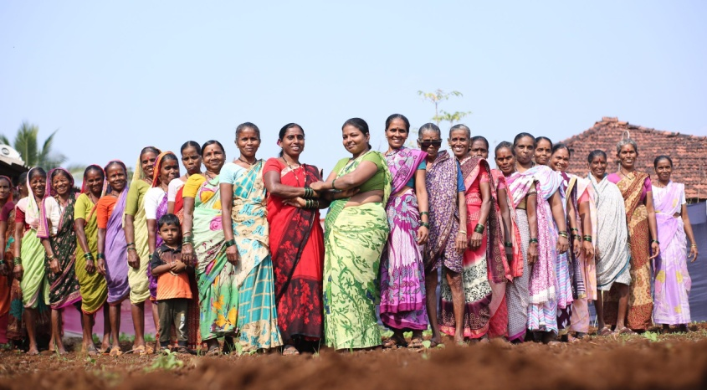
SMT. B. D. JAIN GIRLS P.G COLLEDE
WELCOME TO MY RESEARCH PROJECT ON
ECONOMICS DEVELOPMENT ON RURAL WOMEN
SUBMITTED BY:
SANOVER USMANI
D/O MR. SAEED USMANI
B.A( SIXTH SEMESTER)
ROLL NO : 2200050011276
SUBMITTED BY
MRS. GARIMA MAM &
ANURADHA MAM

Slide 2
ACKNOWLEDEMENT
Everyone who support me to do this wonderful research report and I know lots of new things while doing this research first and foremost, I am deeply grateful to Dr. GARIMA MAM our Economics Instructor, for their invaluable guidance, support and encouragement throughout this project. Their expertise and insights have been instrumental in shaping my understanding and execution of the practical. I would also like to acknowledge the support of my classmates and friend

Slide 3
CERTIFICATE
This is certificate that SANOVER USMANI student of (sixth semester).
Has successfully completed the research report of Economics Development Of Rural Women.
Under my super vision. She has in partial fulfillment of the requirement of the degree of Becholor of Art.
At SMT. B.D. JAIN GIRLS P.G COLLEGE. We acknowledge the diligent effort, dedication and comprehensive research demonstrated in this report.

Slide 4
ECONOMIC DEVELOPMENT OF RURAL WOMEN
Rural women are key agents for development. They play a catalytic role towards achievement of transformational economic, environmental and social changes required for sustainable development. But limited access to credit, health care and education are among the many challenges they face.

Slide 5
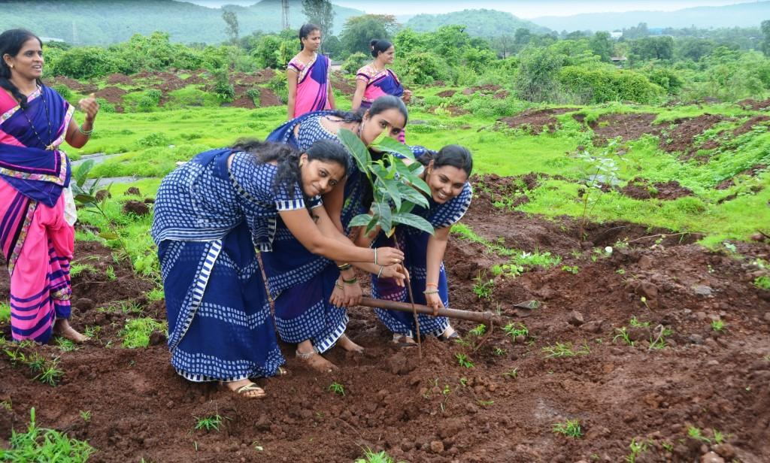

Slide 6
GLOBAL INITIATION
A global initiative, the Economic Empowerment of Rural Women MPTF aims to accelerate progress towards securing the livelihoods, rights and resilience of rural women by building on the comparative advantages of partners to improve socioeconomic opportunities for women in rural areas.
Initiatives help rural women enhance food security status, leadership opportunities, community participation, access to social protection, legal, and economic services, and boosting their productive potential.

Slide 7
WOMEN ROLE IN ECONOMIC
Women's economic participation promotes agricultural productivity, enterprise development at the micro, small, and medium enterprise levels, as well as enhances business management and returns on investment.
Rural development usually refers to the method of enhancing the quality of life and financial well-being of individuals, specifically living in populated and remote areas. Traditionally, rural development was centred on the misuse of land-intensive natural resources such as forestry and agriculture.

Slide 8
CONCLUTION
India has a range of provisions and laws for women in India, that safeguard their rights across various aspects of life such, as criminal offenses, family issues etc.
These law have played a role in shielding women from discrimination and violence while fostering gender equality.

Slide 9
THANK YOU

